Slide 1
Quality Standup: Change Management Thursday 3/13: 1:30-2:30pm PT Most current deck always at: https://aka.ms/CAIQ-CMDeck
Notes:
ChangeMgmtTopWorkItems.xlsx

Slide 2
Agenda
Mike
Topic
Production Touch Analysis Manual Touches - last 30 days Production Touch Analysis Outage Analysis R2D Franchise onboarding TSG Analysis QCR Burndown | Jeff/Mike
Production Touch Improvements Safefly/R2D improvements Developer code of conduct R2D Skip/Escape analysis JIT improvements Blocking safe deletes and Portal improvements Safe Actions | Mike/Imran/Jeff/Satya
Service Deep Dives: Starting engagement with all SQCS, moving service deep dives to their own meeting per prior meetings feedback.

Slide 3
Week over week Key learnings
Mike
Action plans and learnings observed as we move users through the spectrum of safe changes
Kicked off engagement with 24 SQCS teams to understand their production touches and provide guidance on safety of production touches
Based on the discussions we’ve noted learnings below :
Category | Learnings | Action Plans | Owner | Slide
Touch Analysis | Of the 5 services that we engaged with in the first phase had some data that was not available in PTD | Service Fabric and Asguard onboarding were picked up as top priority from the backlog of data sources to onboard to PTD | OFP Safety Team. Service Fabric, Asgard Team | 8
 | Lack of a built-in Subscription level role that has write permissions except delete (e.g. scale out resources). | Revisiting Subscription RBAC levels with team. | RBAC team | N/A
 | Fine tuning required for the PTD system generated risk levels for operations taking in feedback from service teams | Evaluating system for user tagging for conflicting risk levels of operations | OFP Safety team | N/A
Touch Improvements | SQCS services like Service Bus, SDN pubsub, use Service Fabric explorer for operations like reboot replicas as a part of DRI activities. | Service fabric guard rails : Use cluster health SF state to prevent destructive operations, e.g. removing the primary replica if there is no quorum of secondary replicas | Service Fabric team | 8
 | Dynamic Configuration Tool is used by CRP team for feature flighting and feature flag updates in production | Instead of custom DC Tool, investigate if Skylarc could be an option and move these operations to Skylarc. | CRP team | 8
 | Supporting robust resource deletes with ARM Templates and EV2 | Finalizing plan on DeploymentStacks integrations and EV2 | ARM team | 22

Slide 4
Production Touch Analysis Weekly Touches
TSG Analysis
ICM Changes
Outage Analysis
Notes:
ChangeMgmtTopWorkItems.xlsx

Slide 5
S-QCS DRI touch analysis summary and status
Area | Service | LT owner | Contact | Manual touch analysis completion ETA | ETA for Safety Improvements of Manual Touches | ETA for 100% coverage in PTD
Networking | SdnPubSub | Deepak | Qi Zhang, Dong Li | Completed | Completed | TBD
 | Fabric Network Devices (Phynet) | Erica | Lihua Yuan, Bijal Ghedia | Completed | TBD | 3/30/2025
 | Network Resource Provider (NRP) | Deepak | Brandon Wilson, Mingquan Xue | 3/6 | 05/31 | TBD
 | AFD | Abhishek | Anirudh Goel | 3/17 | TBD | TBD
 | DNS (DNS Public Zones, DNS Serving Plane, MSFT.RR DNS) | Abhishek | Karthikeyan Ravichandran, Swati Tiwari | 3/10 | TBD | TBD
 | ATM | Abhishek | Abhishek Agarwal, Yunus Basagalar | 3/10 | TBD | TBD
 | Software Load Balancer (SLB) | Deepak | Amit Kumar, Grzegorz Bajkowski | 3/5 | TBD | Complete
 | Regional Network Manager | Deepak | Naveen Prabhat,Thomas Lai, Brandon Wilson | 3/5 | TBD | TBD
 | Express Route | Pankaj | Bikash Agrawala, Niteesh Kumar | 3/31 | TBD | TBD
 | Core WAN | Erica | Somesh Chaturmohta, Yu-Shun Wang | 3/17 | TBD | TBD
 | Network Service Manager (NSM) | Deepak | Brandon Wilson, Zhenhua Yao | 3/5 | TBD | TBD
 | Azure Virtual Network and Private Link | Deepak | Brandon Wilson, Neeraj Motwani, Rishabh Tewari | 3/7 | TBD | TBD
Compute | Azure Host Agent | Arun | Francis David, Remya Krishnan | Completed | TBD | Complete
 | Compute Resource Provider | Arun | Sameer Motwani, Bishwarup Paul, Mani Durai | Completed | 03/31 | Complete
Storage | XStore | Marcus | Aditya Pillalamarri | ETA for ETA 3/7 | TBD | TBD
 | Disk Resource Provider | Ahmed | Md Sohrabuddin, Vikram Dhaneshwar | Completed | Work to start in <Br> | TBD
 | Azure NetApp Files | Cristian | Paulo Costa | Completed | TBD | 6/30/2025
 | SRP | Ahmed | Martha Amirzadeh | 3/14 (Tentative) | TBD | TBD
Specialized | Azure VMWare Solution | Anand | Christopher Boumenot | Completed | TBD | TBD
Data | Cosmos DB | Peter Carlin | Debarshi Bhowal, Heather Harding | TBD | TBD | TBD
 | Service Bus | Peter Carlin | Arun Dsouza | 3/5 | TBD | 6/30/2025
 | SQL DB | Peter Carlin | Jack Li, Heather Harding | Started - TBD | TBD | TBD
Completed
In progress
Blocked

Slide 6
PTD Prioritized Source Data
Production Touch Dashboard today covers 12 targets / interfaces for operations and touch data :
We have a known backlog of sources that we are onboarding. Below are the sources that are currently prioritized from the backlog for the next two quarters after the SQCS reach out :
ARM | Geneva Actions
Fabric | SLB
XDS | SDNPubSub
dSMS | NRP
RNM | PilotFish
SoC | Other (CRP, Hudson Service)
Target | Description | ETA | Current Status
Asgard Service Fabric | Service Fabric managed clusters. This includes WARP clusters: Host for core RPs like CRP, SFRP, NRP, DiskRP, Atlas | 3/7 | In progress
AzNet NW Device | Physical network production touch data | 3/31 | In progress
Linux Host | Prod Touch data related to Linux Host VMs. Very low volume but critical for services like Azure VMWare solution and Azure NetApp files | ETA for ETA 3/13 | In progress
SQL Azure CAS | Legacy management tool used to manage SQL Azure infrastructure | ETA for ETA 3/13 | In progress
Standalone Service Fabric | Custom SF cluster on environment of choice | ETA for ETA 3/13 | In progress
Anvil | service designed to handle Azure repairs, diagnostic collection, and incident generation. Chance of double counting as the operations will be logged in Fabric logs as well which we are already ingesting | ETA for ETA 3/13 | In progress

Slide 7
Manual Touch Summary
Mike
Duration: 02/20/2025 to 02/26/2025
Scope: Super QCS services
Count of all Non-Read operations performed by User identities
¹Does not include touches via Geneva Actions due to attribution issue – engineering team is fixing the issue.
Does not include data about touches to physical devices like networking physical network devices.
Services | Interface¹ | Click Touch |  |  |  |  |  | Scripted |  |  |  |  |  | Total Touches
 |  | IAR | Extreme | High | Moderate | Low | Unknown | IAR | Extreme | High | Moderate | Low | Unknown
Xstore | ARM | - | - | - | 1 | - | - | - | - | - | - | - | - | 1
 | Fabric | - | - | - | 293 | - | - | - | - | - | - | 12 | - | 305
 | XDS | - | - | 4578 | 3689 | 48 | 105 | - | - | 516 | 312 | 1912 | - | 11160
Software Load Balancer | SLB | - | - | - | - | - | - | - | - | 4 | 6987 | - | - | 6991
Azure VMware Solution | ARM | 2 | 13 | 16 | 277 | - | - | 3 | 2 | 9 | 462 | - | - | 784
Azure Frontdoor | ARM | 5 | 6 | 47 | 195 | - | - | - | - | - | 187 | - | - | 440
Azure Cosmos DB | ARM | 50 | 10 | 11 | 180 | - | - | - | - | - | 4 | - | - | 255
 | dSMS | - | - | - | - | - | - | - | - | - | 1 | 4 | - | 5
Service Bus | ARM | 6 | 6 | 5 | 178 | - | - | - | - | - | 57 | - | - | 252
Azure Host Agent | ARM | - | 1 | - | - | - | - | - | - | - | - | - | - | 1
 | Fabric | - | - | 1 | 54 | - | - | 14 | - | - | 31 | 5 | - | 105
SQL DB Prod Clusters | ARM | - | - | - | 26 | - | - | - | - | - | 10 | - | - | 36
 | dSMS | - | - | - | - | - | - | - | - | - | 59 | 5 | - | 64
Azure DNS Public Zones | dSMS | - | - | - | - | - | - | - | - | - | - | 79 | - | 79
Linux Serving Plane - Azure DNS | dSMS | - | - | - | - | - | - | - | - | - | 74 | - | 1 | 75
ExpressRoute | ARM | - | - | - | 6 | - | - | - | - | - | 19 | - | - | 25
 | Fabric | - | - | - | - | - | - | - | - | - | 2 | - | - | 2
Application Gateway | ARM | 6 | 1 | - | 18 | - | - | - | - | - | - | - | - | 25
CoreWAN | ARM | - | - | - | 22 | - | - | - | - | - | - | - | - | 22
MSFT.RR DNS | dSMS | - | - | - | - | - | - | - | - | - | 12 | - | - | 12
SRP | ARM | - | - | - | 1 | - | - | - | - | - | 5 | - | - | 6
 | XDS | - | - | - | - | - | - | - | - | - | 3 | - | - | 3
Network Resource Provider | ARM | 3 | 2 | - | 3 | - | - | - | - | - | - | - | - | 8
Azure NetApp Files | ARM | - | 5 | - | 1 | - | - | - | - | - | - | - | - | 6
DNS Serving Plane | dSMS | - | - | - | - | - | - | - | - | - | 2 | - | 1 | 3
Network Service Manager | ARM | - | - | - | 2 | - | - | - | - | - | - | - | - | 2
Regional Network Manager | dSMS | - | - | - | - | - | - | - | - | - | 1 | - | - | 1
Disk Resource Provider | ARM | - | - | - | - | - | - | - | - | - | 1 | - | - | 1
Grand Total |  | 72 | 44 | 3858 | 4882 | 46 | 0 | 17 | 2 | 528 | 8162 | 1509 | 23 | 19143
Duration: 01/01/2025 to 01/31/2025
Scope: Super QCS services
Count of all Non-Read operations performed by User identities
IAR- Immediate action required
See Appendix for risk rating taxonomy

Slide 8
Manual Touch Summary Last Week
Mike
Duration: 02/13/2025 to 02/19/2025
Scope: Super QCS services
Count of all Non-Read operations performed by User identities
¹Does not include touches via Geneva Actions due to attribution issue – engineering team is fixing the issue.
Does not include data about touches to physical devices like networking physical network devices.
Services | Interface¹ | Click Touch |  |  |  |  |  | Scripted |  |  |  |  |  | Total Touches
 |  | IAR | Extreme | High | Moderate | Low | Unknown | IAR | Extreme | High | Moderate | Low | Unknown
Xstore | ARM | - | - | - | 18 | - | - | - | - | - | - | - | - | 18
 | Fabric | - | - | - | 231 | - | - | - | - | - | 32 | 32 | - | 295
 | XDS | - | - | 1959 | 2225 | 1601 | - | - | - | - | - | - | - | 5785
Azure VMware Solution | ARM | 4 | 4 | 26 | 200 | - | - | 201 | - | - | 883 | - | - | 1318
Software Load Balancer | SLB | - | - | - | - | - | - | - | - | - | 1110 | - | - | 1110
SQL DB Prod Clusters | ARM | - | 33 | - | 38 | - | - | - | - | - | 271 | - | - | 342
 | dSMS | - | - | - | - | - | - | - | - | - | 54 | 17 | - | 71
 | Fabric | - | - | - | - | - | - | - | - | - | 49 | - | - | 49
Service Bus | ARM | - | - | 169 | 73 | - | - | - | - | - | 91 | - | - | 333
 | dSMS | - | - | - | - | - | - | - | - | - | - | 36 | - | 36
Azure Host Agent | Fabric | - | - | - | 149 | - | - | - | - | - | 13 | 2 | - | 164
Azure Cosmos DB | ARM | 21 | 4 | - | 58 | - | - | 3 | 2 | 6 | 18 | - | - | 112
 | dSMS | - | - | - | - | - | - | - | - | - | 1 | - | - | 1
Azure Frontdoor | ARM | 2 | - | 33 | 52 | - | - | - | - | - | - | - | - | 87
Application Gateway | ARM | 9 | - | - | 9 | - | - | - | - | - | 28 | - | - | 46
Compute Resource Provider | Other | - | - | - | - | - | - | - | - | - | 39 | - | - | 39
Azure NetApp Files | ARM | 1 | 2 | 4 | 28 | - | - | - | - | - | - | - | - | 35
CoreWAN | ARM | 7 | 1 | - | 23 | - | - | - | - | - | - | - | - | 31
SRP | ARM | 2 | - | - | 10 | - | - | 2 | - | - | 5 | - | - | 19
 | dSMS | - | - | - | - | - | - | - | - | - | 6 | - | - | 6
 | XDS | - | - | 1 | - | - | - | - | - | - | - | - | - | 1
Network Resource Provider | ARM | 3 | 5 | - | 8 | - | - | - | 1 | - | - | - | - | 17
Regional Network Manager | dSMS | - | - | - | - | - | - | - | - | - | 6 | - | - | 6
 | RNM | - | - | - | - | - | - | - | - | - | 1 | - | - | 1
MSFT.RR DNS | dSMS | - | - | - | - | - | - | - | - | - | - | 4 | - | 4
Azure DNS Public Zones | ARM | - | - | - | 3 | - | - | - | - | - | - | - | - | 3
Total Touches |  | 49 | 49 | 2192 | 3125 | 1601 | 0 | 206 | 3 | 6 | 2607 | 91 | 0 | 9929
Duration: 01/01/2025 to 01/31/2025
Scope: Super QCS services
Count of all Non-Read operations performed by User identities
IAR- Immediate action required
See Appendix for risk rating taxonomy

Slide 9


In progress- Sguardo Update Only –
All changes should be made in IcM (source of truth). Please add a comment for deltas
Jeff
Change Related Outage breakdown (2/27 to 3/5)
Insights
During the period of 27Feb to 6 Mar, there were a total of 15 Change-Related outages - (same as previous week)
Most impactful outage occurred when a DNS record was deleted – IDNA followed legacy process with insufficient guardrails. Franchise is addressing systematically.
The OneDeploy outage with 17 critsits highlighted an additional production interface that needs to be brought into R2D scope: ObjectStore
Power BI not fully onboarded to R2D, working with franchise to accelerate / address change safety gaps.
3
3
Incident Id | Date | Sev | Franchise Owner | Impacted Service | Responsible Service | R2D Skip Escape | IsPilot Escape | Impacted Regions | CritSits | TTC | Change Type | Tool/ Interface | TTO | TTM | Mitigation Type | Time to Rollback | Auto-stop (healthcheck) | Manual Touch | Quality Critical Repairs
N/A
601413900 | 2/27 | 2 | N/A | Cognitive Services | Cognitive Services | None | True | 27 | 14 | -186 | Orchestrated change | Other | 191 | 381 | Unknown | TBD | TBD | TBD | TBD
601667279 | 2/28 | 2 | N/A | MCIO-GlobalDatacenterOperations | MCIO-GlobalDatacenterOperations | None | True | 1 | 1 | 52 | TBD | TBD | 59 | 272 | Roll Forward | TBD | TBD | TBD | TBD
DevDiv Franchise – CVP Bilal Alam 69/81 services adopted R2D
601090647 | 2/27 | 2 | Petr Podhorsky | App Service (Web Apps) | App Service (Web Apps) | TBD | True | TBD | 3 | -4471 | TBD | TBD | 2643 | 92 | Unknown | TBD | TBD | TBD | TBD
602569235 | 3/3 | 2 | Petr Podhorsky | API Management | API Management | TBD | True | TBD | 0 | N/A | Orchestrated change | Ev2 | 157 | 200 | Unknown | TBD | TBD | TBD | TBD
603383764 | 3/5 | 2 | Petr Podhorsky | API Management | API Management | TBD | True | TBD | 0 | N/A | Orchestrated Change | Ev2 |  |  | Unknown | TBD | TBD | TBD | TBD
603614615 | 3/5 | 2 | Vojtech Vondra | CPIM | CPIM |  | True | Global | 1 | 10726 | TBD | TBD | 95 | 12040 | Rollback | TBD | TBD | TBD | TBD

Slide 10
Jeff
Change Related Outage breakdown (2/27 to 3/5)
In progress- Sguardo Update Only –
All changes should be made in IcM (source of truth). Please add a comment for deltas
Incident Id | Date | Sev | Franchise Owner | Impacted Service | Responsible Service | R2D Skip Escape | IsPilot Escape | Impacted Regions | CritSits | TTC | Change Type | Tool/ Interface | TTO | TTM | Mitigation Type | Time to Rollback | Auto-stop (healthcheck) | Manual Touch | Quality Critical Repairs
Data Franchise– CVP Peter Carlin 17/118 services adopted R2D
602595168 | 3/3 | 3 | Peter Carlin | Trident DW - SQL Lake Platform | Trident DW - SQL Lake Platform | TBD | True | TBD | 1 | -1553 | Orchestrated change | Other | 1448 | 2180 | Roll Forward | TBD | TBD | TBD | TBD
601566882 | 2/28 | 2 | Peter Carlin | Azure Synapse Platform Service | Azure Synapse Platform Service | TBD | True | TBD | 0 | N/A | TBD | TBD | 1224 | 1029 | Unknown | TBD | TBD | TBD | TBD
603158972 | 3/4 | 2 | Peter Carlin | Fabric Platform Shared Services | Fabric Platform Shared Services | TBD | True | TBD | 0 | N/A | TBD | TBD | 203 | 49 | Roll Forward | TBD | TBD | TBD | TBD
603473235 | 3/5 | 2 | Peter Carlin | Azure Synapse Platform Service | Azure Synapse Platform Service | TBD | True | TBD | 0 | N/A | Orchestrated change | Other |  | 122 | Roll Forward | TBD | TBD | TBD | TBD
603482709 | 3/5 | 2 | Peter Carlin | Azure Synapse Platform Service | Azure Synapse Platform Service | TBD | True | TBD | 0 | N/A | Orchestrated change | Other |  | 93 | Roll Forward | TBD | TBD | TBD | TBD
601243283 | 2/27 | 2 | Peter Carlin | SOS/RG/CLR Host | SOS/RG/CLR Host | TBD | True | 1 | 0 | N/A | Production manual touch (non-scripted) | JIT | 5 | 3386 | Roll Forward | TBD | TBD | TBD | TBD
AEP franchise – CVP John Sheehan 13/561 services adopted R2DTBD
601283620 | 2/27 | 2 | Irina Gorbach | Cloud Transfer Service | Cloud Transfer Service |  | True |  | 0 | N/A | Orchestrated change | Manual Touch - Portal | 1148 | 1184 | Roll Forward | TBD | TBD | TBD | TBD
603596417 | 3/5 | 2 | Irina Gorbach | OneBranch Services | OneBranch Services |  | True |  | 0 |  | Orchestrated change | AzDeployer | 42 | 95 | Rollback | TBD | TBD | TBD | TBD
601338879 | 2/27 | 2 | Irina Gorbach | Application Insights | Application Insights | Skip | True | 1 | 0 | N/A | Orchestrated change | Ev2 | 28 | 139 | Rollback | TBD | TBD | TBD | TBD
603533880 | 3/5 | 2 | Irina Gorbach | Application Insights | Application Insights | None | True | 1 | 0 |  | Orchestrated change | Other | 20152 | 20398 | Unknown | TBD | TBD | TBD | TBD
602796551 | 3/3 | 2 | Irina Gorbach | Service Map and VM Insights | Service Map and VM Insights | None | True | 16 | 0 |  | Orchestrated change | Ev2 | 71829 | 71100 | Roll Forward | TBD | TBD | TBD | TBD

Slide 11
R2D Skips and Escapes (2/27 to 3/5)
Jeff
Hari In progress- Franchise Owners – please provide Change Safety learnings – thank you so much!
Insights - Need to enhance awareness with the Franchises through the Owners for following through the R2D review process towards SDP.
Outage | Franchise & Service | Skip / Escape | Comment Feedback from Franchise owner or delegate on what caused the skip or escape and what improvements are being made to reduce the likelihood of recurrence
 | Franchise: DevDiv-Franchise Service: Franchise Owner & CVP: |  | Summary: Deployment Tool: Change Safety Learnings: [Franchise Owners Please Update]
 | Franchise: DevDiv-Franchise Service: Franchise Owner & CVP: |  | Summary: Deployment Tool: Change Safety Learnings: [Franchise Owners Please Update]
 | Franchise: DevDiv-Franchise Service: Franchise Owner & CVP: |  | Summary: Deployment Tool: Change Safety Learnings: [Franchise Owners Please Update]
 | Franchise: Data Service Franchise Owner & CVP: Peter Carlin |  | Summary: Deployment Tool: Change Safety Learnings: [Franchise Owners Please Update]
 | Franchise: Data Service Franchise Owner & CVP: Peter Carlin |  | Summary: Deployment Tool: Change Safety Learnings: [Franchise Owners Please Update]
 | Franchise: Data Service Franchise Owner & CVP: Peter Carlin |  | Summary: Deployment Tool: Change Safety Learnings: [Franchise Owners Please Update]
 | Franchise: Data Service Franchise Owner & CVP: Peter Carlin |  | Summary: Deployment Tool: Change Safety Learnings: [Franchise Owners Please Update]
 | Franchise: Data Service Franchise Owner & CVP: Peter Carlin |  | Summary: Deployment Tool: Change Safety Learnings: [Franchise Owners Please Update]
 | Franchise: Data Service Franchise Owner & CVP: Peter Carlin |  | Summary: Deployment Tool: Change Safety Learnings: [Franchise Owners Please Update]
Notes:
As a drill down for the R2D skips and escapes from previous slide, you’ll see the 3 risk assessments that were downgraded. We’ll start tracking risk assessment changes to see what be missing in the calculation to be more accurate, but also specifically flagging those in the franchise discussions.
a call out on the last outage was related to a feature flag that was a missing during the deployment
//////////
591610343 – Change Safety Learnings Additional Context: The core issue here was there were 3 feature flags, all 3 were enabled in stage/canary/preprod and went through necessary validation. When enabling in pilot they enabled 2 of the flags, didn't the 3rd. So the R2D QRs asked all the right questions, confirmed all quality gates were met and that the change had SDP'ed across the frontline and was good to go to pilot but they hadn't seen the goal state PRs for preprod/stage/canary to confirm the same changes were going to Pilot. That is the new ask that we are proposing R2D reviewers follow here forward with this
List of deployments, production touches, skips, and escapes experienced by R2D franchises along with comments from the accountable franchise owners on why the skip/escape happened and what they are doing to reduce the risk of a recurrence.
Onboarded = bringing deployments in Safefly (Enabled in SF and >1 deployment in last 90 days)
* #unsafe prod touch only tracked for R2D onboarded services
** AEP R2D reviews happen via central, franchise in progress
R2D adoption status
# of skips & links to the outages
# of escapes & links to the outages
Tool used to deploy the changes
Relevant SafeFly requests
Franchise owner comments on how the skip/escape occurred & mitigation steps implemented

Slide 12
R2D Skips and Escapes (2/27 to 3/5)
Jeff
Hari In progress- Franchise Owners – please provide Change Safety learnings – thank you so much!
Outage | Franchise & Service | Skip / Escape | Comment Feedback from Franchise owner or delegate on what caused the skip or escape and what improvements are being made to reduce the likelihood of recurrence
 | Franchise: AEP-Franchise Service: Franchise Owner & CVP: Irina Gorbach & John Sheehan |  | Summary: Deployment Tool: Change Safety Learnings: [Franchise Owners Please Update]
 | Franchise: AEP-Franchise Service: Franchise Owner & CVP: Irina Gorbach & John Sheehan |  | Summary: Deployment Tool: Change Safety Learnings: [Franchise Owners Please Update]
Notes:
As a drill down for the R2D skips and escapes from previous slide, you’ll see the 3 risk assessments that were downgraded. We’ll start tracking risk assessment changes to see what be missing in the calculation to be more accurate, but also specifically flagging those in the franchise discussions.
a call out on the last outage was related to a feature flag that was a missing during the deployment
//////////
591610343 – Change Safety Learnings Additional Context: The core issue here was there were 3 feature flags, all 3 were enabled in stage/canary/preprod and went through necessary validation. When enabling in pilot they enabled 2 of the flags, didn't the 3rd. So the R2D QRs asked all the right questions, confirmed all quality gates were met and that the change had SDP'ed across the frontline and was good to go to pilot but they hadn't seen the goal state PRs for preprod/stage/canary to confirm the same changes were going to Pilot. That is the new ask that we are proposing R2D reviewers follow here forward with this
List of deployments, production touches, skips, and escapes experienced by R2D franchises along with comments from the accountable franchise owners on why the skip/escape happened and what they are doing to reduce the risk of a recurrence.
Onboarded = bringing deployments in Safefly (Enabled in SF and >1 deployment in last 90 days)
* #unsafe prod touch only tracked for R2D onboarded services
** AEP R2D reviews happen via central, franchise in progress
R2D adoption status
# of skips & links to the outages
# of escapes & links to the outages
Tool used to deploy the changes
Relevant SafeFly requests
Franchise owner comments on how the skip/escape occurred & mitigation steps implemented

Slide 13
TSG “ClickTouch” Remediation Status Update 3-03-2025
Jeff
 |  |  |  |  | TSG Risk Awareness & Reduction |  |  | TSG Risk Mitigation
TSG Type/Category | Denominator | Total TSGs Scanned | ClickTouch Detected |  | SafeFly Banner | Safe Alternative(s) Suggested |  | Orchestration Tool Template(s) | ClickTouch Elimination
SFI | 115 KPIs | 137 | 110 |  | 110 | 20 |  | 11 | 20
QEI | 22 KPIs | 34 | 18 |  | 15 | 2 |  | 0 | 3
ICM TSG Links | n/a | 276 | 119 |  | 0 | 104
Total | 137 KPIs | 447 | 247 |  | 115 | 126 |  | 11 | 9
SFI/QEI/ICM TSG Links Progress (get green)
TSG ClickTouch risk mitigation achieved for 15% of KPIs (20 of 137).
Click touches eliminated from 20 TSGs (+9 this week)
Completed ICM TSG Scan and found 119 TSGs with click touch
Safer suggestions added 104 of the TSGs (+104/119 this week)
Identified # of TSGs with resource delete count – SFI 42, QEI 1
Prioritizing remediation this week
Prevention (stay green)
Templatized safe guidance that can be re-used for many TSGs that gives required safe tool guidance (done 3/3)
SRE GitOps Bot solution (scans for unsafe TSG guidance during each step of the dev process and blocks non-safe PRs) will publish to pre-prod – ETA: 3/14.
Next steps: GitOps Bot running on Managed Identity, building CI/CD Pipeline, API dev & Integration with TSG Analyzer, Event handling + response rendering.
Private Preview estimated: April 2025.
Notes:
Notes:
-Added QEI wave 5 TSGs into data set, see increase in denominator and clicktouch detection for QEI.
-Initial scan results add from ICM TSG Links, see details in table. Please note, remediation for this line item will focus on risk awareness as elimination is not possible in all scenarios.
-Initial results for resource delete added as a bullet point, more work is needed to refine LLM prompt and validate results before actioning.
Talking Points
TSG ClickTouch risk mitigation achieved (through the application of orchestration tool templates OR removal of ClickTouch reference in TSG) for 15% of KPIs (20 of 137).
ICM TSG Links scan results indicate that 119 of 276 TSGs have ClickTouch detected. 104 with ClickTouch do provide reference to Safe Orchestrators.
We’re developing the SRE GitOps Bot that standardizes, regulates, and gates TSGs during each step of the development process, blocking pull requests (PRs) with non-SDP remediation methods and non-IaaC methods (ARM / BICEP templates via EV2).
Next steps: GitOps Bot running on Managed Identity, building CI/CD Pipeline, API Development & Integration with TSG Analyzer, Event handling + response rendering.
Private Preview estimated: End of April 2025.

Slide 14
Production Touch Improvements Plan
Risk Assessment: Safefly/R2D improvements
Developer code of conduct
R2D skips
Safe Approval: JIT improvements
Manual ARM Delete Operations: AME insights Execute Action – Click Touch Safety: Blocking safe deletes and Portal improvements
Execute Action – Scripted Touch Safety: Defining and enforcing Safe Actions
Notes:
ChangeMgmtTopWorkItems.xlsx

Slide 15
Risk Assessment Improvements
Imran
Workstream | Owner | Status & Next Steps
SafeFly: New Manual Touch-specific form for R2D reviews | SanGeo | Complete: Tailor SafeFly form for click vs. scripted touches.
SafeFly: New Buildout/Decom-specific form for R2D reviews | CFernandez | Complete: 2/20 - Delivery of SafeFly requirements document to SafeFly team – Scheduling read out call for week of 2/24 Next: implement new form in SafeFly (ETA for ETA 2/24).
ARG + R2D: surface info on resources dependents & dependencies to help R2D Approver | DattR, Veena | Proposal doc complete. ETA for ETA 3/13.
Geneva Actions: identify which operations are truly read-only vs not. | DattR | ~3/28 - In Progress. Investigating telemetry and static analysis options (encouraging early results).
Azure Build Health: improvements (additional data for risk analysis) + SafeFly integration | FredBh | Complete: ABH + R2D/Safefly integration in production (2/14).
Azure Build Health: Auto-generate (Copilot) release summaries & risks identification (VIRA) | BeHumphr | Complete: release summaries integrated into ABH. In progress: additional risk identification & quality.

Slide 16
Safe Approval Improvements
Imran
Workstream | Owner | Status & Next Steps
Developer code of conduct attestation | Imran | Complete: updated from initial round of testing. 3/3. In progress: staged rollout for US-based employees. Non-US based employees to follow pending closure on open issues. Azure Data pursuing customized guidance (key concern is very high volume of production touches and people’s ability to immediately adhere).
JIT: restrict and refine eligible approvers | VeenaR | Complete: SDN PubSub. Next: proposal for a standardized policy to apply at scale. ETA for ETA is 3/10.
JIT: require approved SafeFly request. | VeenaR | Complete: v-team (R2D, JIT, Trusted Platform, etc) alignment on approach. 3/19. In Progress: Dev implementation.
R2D: Livesite Mitigations to require EIM/ED/IM approval for Sev 0-2 and full R2D for higher | SanGeo | 2/27: There are 550+/1280 services onboarded to SafeFly that have IcM teams without escalation path. R2D to follow-up with services to get IcM path – this is critical for EIM/IM workflow for JIT and Livesite Mitigations through R2D 2/21. 3/20 Complete updates to SafeFly workflow. Ensure all services have the right approvers configured to avoid delays. Analyze outage/bridge details to estimate TTM impact of R2D approval. R2D approval non-blocking (until JIT integration next month)
R2D: Enforce R2D approval for all health stops bypasses (below ARM) | IshaSahu | Complete: Manual audit process currently in place. TBD: Automated enforcement to require R2D approval prior to deployment stop bypass (pending achieving lower false positive rate).

Slide 17
Making Manual ‘Prod’ Touches Safer Above ARM Delete Operations in the last 30days
Satya
Resource Type | Count of resources deleted | Percentage | Is Geneva Action’s Shared Operation Available? | Identify Safety Checks
...NETWORK/TRAFFICMANAGERPROFILES/EXTERNALENDPOINTS | 6,239 | 19% | No | In-Progress
...AUTHORIZATION/ROLEASSIGNMENTS | 6,200 | 19% | Yes | -
...NETWORK/PRIVATEDNSZONES/A | 3,249 | 10% | No | In-Progress
...RESOURCES/SUBSCRIPTIONS/RESOURCEGROUPS | 2,120 | 7% | Yes | -
...NETWORK/PUBLICIPADDRESSES | 1,841 | 6% | No | In-Progress
...STORAGE/STORAGEACCOUNTS | 1,085 | 3% | Yes | -
...COMPUTE/VIRTUALMACHINESCALESETS | 925 | 2% | Yes | -
...INSIGHTS/DATACOLLECTIONENDPOINTSRULES | 800 | 1% | No
...STORAGE/STORAGEACCOUNTS/BLOBSERVICES/CONTAINERS | 781 | 1% | No
...NETWORK/DNSZONES/CNAME | 558 | 1% | No | In-Progress
…NETAPP/NETAPPACCOUNTS/CAPACITYPOOLS/VOLUMES | 491 | 1% | No
...SQL/SERVERS/FIREWALLRULES | 342 | 1% | No
...COMPUTE/CLOUDSERVICES | 312 | 1% | No
...NETWORK/LOADBALANCERS | 312 | 1% | No
...CONTAINERINSTANCE/CONTAINERGROUPS | 245 | 1% | No
...NETWORK/NETWORKINTERFACES | 205 | 1% | No | In-Progress
Total | 19K | 56%
4 out of top 26 deleted resources have a Geneva Action shared operation
Total of 267 resource types deleted
Notes:
Should we include all changes in this scope for Crawl, Walk, Run? (Datta) current scope is deletes. Reconcile the list of planned GA actions with the most popular delete operations.
Tooling experience may not be great but building safety into whatever client they are using
What are we doing to guide users to safe systems
R2D Assistant API
VirtualMachines_Delete StorageAccount_Delete Vmss Delete Delete Traffic Manager Endpoint Delete Traffic Manager Profile FleetDiagnosticsRequestVM FleetDiagnosticsRequestVMSS CreateRoleAssignment DeleteRoleAssignment UpdateRoleAssignment

Slide 18
Making ‘Prod Touches’ Safer
Satya
Scenario 1: Prevent Accidental Resource Deletions
 | ‘Click Touch’ Workstream | Status | Notes
1. | Define and review approach to prevent RG deletes from non-compliant tools | Completed | Done
2. | Implement Geneva Action with safety checks for RG deletes - Ready to deploy 🎉 | Completed | ETA: 3/5
3. | Enforce blocking RG deletes from the Azure Portal - Ready to deploy 🎉 | Completed | ETA: 3/5
4. | Enforce blocking all resource deletes from non-compliant tools | In-Progress | ETA: 3/31
Scenario 2: Understand change impact and resource dependencies
 | Safe Change Workstream | Status | Notes
1. | Determine the set of safety checks for DNS, Traffic Manager, Azure Front Door | In-Progress | ETA: 3/7
2. | Build Geneva Actions for DNS, Traffic Manager, Azure Front Door | Not started | ETA for ETA 3/12
3. | Build Geneva Actions/Change Validators for remaining SQCS services | Not started | TBD
4. | Proof of Concept that integrates R2D Manual Touch Form/Approval and ARG Dependency API to give approvers more context for approval decision. Starting by analyzing dependencies on Traffic Manager Profiles. | In-Progress | ETA for ETA 3/13
Scenario 3: Ensure all services support soft delete and recovery
 | Soft Delete Workstream | Status | Notes
1. | Meet with Networking teams (DNS, TM, AFD) and critical storage locations (Storage, Cosmos DB, SF-BRS, SQL) to understand status around support for centralized soft delete contract (update to be provided in the next resiliency review) - Conversations with DNS, Traffic Manager, AFD, and SQL done. DNS zones (private/public) are working on design but no ETA | In-Progress | ETA: TBD
Notes:
https://msit.powerbi.com/groups/c1b4652f-efe6-4031-8526-36cc9b27677c/reports/97ad1ce9-ae41-43e5-b669-cad94d398fb9/251faaff70ac2a64dd34?experience=power-bi

Slide 19
Making Production Touches Safer
Mike
Scenario 4: Making use of Geneva Actions & OaaS safe
Today GA/OaaS ensures compliance not safety. This scenario is about 1) expanding the action SDK to require safety measures (rate limiting, rollback etc.) and 2) expanding tools to identify & only execute 'safe actions’
Workstream | Owner | Status & Next steps
[R2D Enhancement] R2D request contains not only the operation but also the parameter for the operation to be executed. | Isha Sahu | Investigating. TBD.
[R2D Enforcement] Proposal for all OaaS operations to only execute production touches that have received approval via R2D | Shilpi Kumari | 3/30
[R2D Enforcement] Proposal for all Geneva Actions operations to only execute production touches that have received approval via R2D | Veena, Sooraj | ETA for ETA 3/15
[Standard Platform] Safe Platform definition document | Veena, Sooraj | Complete – Stakeholder review in progress - ETA 3/10
[Standard Platform] Inventory of platforms and identify capabilities relative to safety maturity model | Veena, Sooraj | Complete – Self attestation from platform owners received.
[Safe Action] Safe Action definition document & stakeholder (Peter, Geoff, Marcus) review | Veena | In progress, ETA 3/10
[GA Safety] Design document: Geneva Actions extension SDK updates for Safe Actions | Datta | ETA to lockdown 3/14 (Implementing Safety for Geneva actions.docx)
[GA Safety] Design document: Geneva Actions tool updates for Safe Actions | Datta, Veena | Investigating, ETA 3/14
[Touch Dashboard] Update to understand safe platform and safe action definitions (remove conforming touches from high risk ratings) | Veena | TBD – depends on stakeholder review of doc.
Notes:
Different tools do we see in the prod touch dashboard: ARM Fabric XDS dSMS RNM SoC Geneva Actions SLB SDNPubSub NRP Other (CRP, Hudson Service)
The "Lightsaber" workstream identified a broad range of config tools used for production touch. The full list of results of the Lightsaber Config Tools survey are available in the Appendix, slide: “Config Tools and Orchestrators”

Slide 20
Safety Capability Matrix – Common Standard Platforms
Mike
We’ve defined the safety requirements / capabilities for standard interfaces / tools and platforms to adhere to for all production touches.
While there are 60+ known interfaces used within C+AI to touch production, below listed are the common standard interfaces / platforms used extensively across C+AI.
For the commonly used standard interfaces /platforms, we received self-attestation from owners on the safety capabilities met by these interfaces / platforms as below.
Next Steps :
Work with interface / platform owner for adding proper safety capabilities and provide systematic enforcement.
Identify mechanisms for PTD to separate safe touches from platform / interfaces that enforce safety requirements.
Duration: 01/01/2025 to 01/31/2025
Scope: Super QCS services
Count of all Non-Read operations performed by User identities
Pipeline | Platform / Interface | Access Control + Security¹ | Audited + Attributed¹ | Managed Risk Review¹ | Safety Prechecks² | Safety Policies² | Health Integration¹ | Testing + SDP² | Rollback² | CCOA Support¹ | Change Classification³
Buildout | Azure CIS | Yes | Yes | TBD | TBD | TBD | Yes | Yes | Yes | Yes | TBD
Deployment | Ev2 | Yes | Yes | Yes | Yes | Yes | Yes | Yes | Yes | Yes | TBD
 | AzDeployer | Yes | Yes | Yes | Yes | Yes | Yes | Yes | Yes | Yes | TBD
 | Skylarc | Yes | Yes | Yes | Yes | Yes | Yes | Yes | Yes | Yes | TBD
 | Oaas | Yes | Yes | Yes | Yes | Yes | Yes | Yes | No | Yes | TBD
Mitigation | Anvil | Yes | Yes | Yes | Yes | Yes | Yes | Yes | Yes | Yes | TBD
 | Geneva Actions | Yes | Yes | No | No | Yes | Yes | Yes | No | No | TBD
 | XDS | Yes | Yes | Yes | Yes | Yes | Yes | No | Yes | No | TBD
 | SQL CAS | Yes | Yes | Yes | Yes | Yes | Yes | No | No | Yes | TBD
 | Repair Agent | Yes | Yes | Yes | Yes | Yes | Yes | Yes | No | Yes | TBD
 | DCM Explorer | Yes | Yes | No | No | No | No | No | No | No | TBD
Diagnostics and Telemetry | Fleet Diagnostics | Yes | Yes | No | No | Yes | Yes | Yes | Yes | No | TBD
1 If Yes, then it means that platform / interface systematically enforces this capability once the service has onboarded to the platform / interface.
2 If Yes, then it means that the platform / interface provides the capability, however service teams need additional work to meet the specific capabilities – not auto applied / enforced by the system.
3 Change classification needs to be discussed for receiving self attestation from interface / platform owners – reach out in progress.

Slide 21
Appendix

Slide 22
Service tree asks
Work in progress – Brainstorming stub
Metadata cleanup ownership
Prod and non-prod subscription metadata tags
System assessed prod/non-prod environment type
More granular than prod/non-prod. For e.g. a non-prod type that is in scope for all S360 and SFI KPIs where teams wants the same prod rigor in their non-prod environments
Overall hygiene and data quality
R2D Franchises unable to discern between prod/non prod
Durable identification of services in scope for R2D
Identification of Tech stack and infrastructure running the service. For e.g.- identify services running on stand-alone service fabric
Fill this slide out to capture our learnings on Service Tree hygiene and the issues the lack of hygiene creates for our other workstreams.
Describe scenarios we are solving for

Slide 23
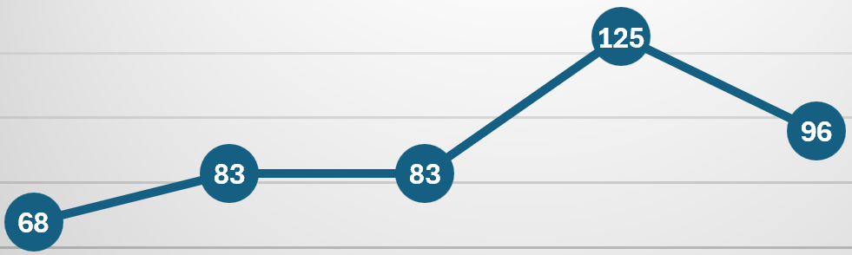
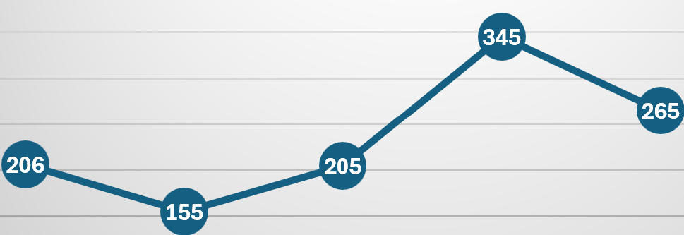
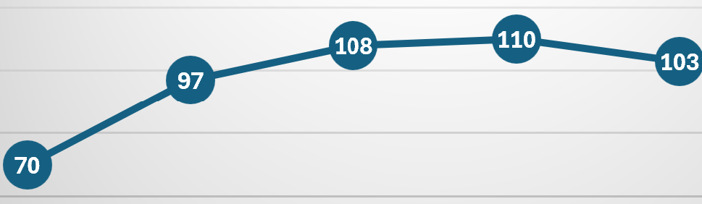
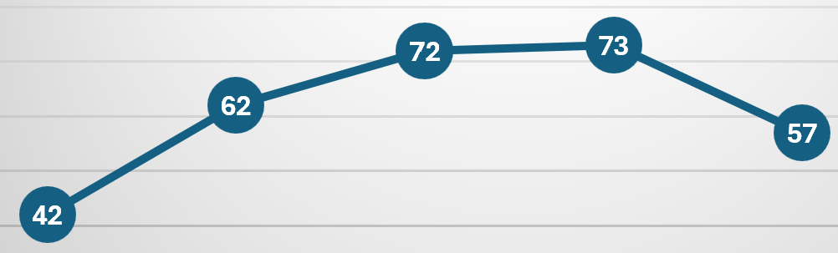
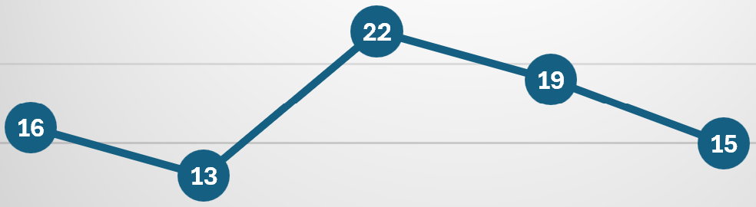
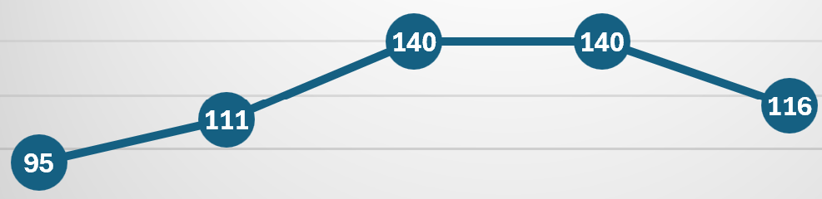
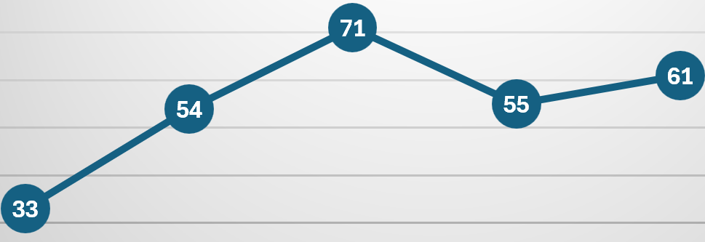
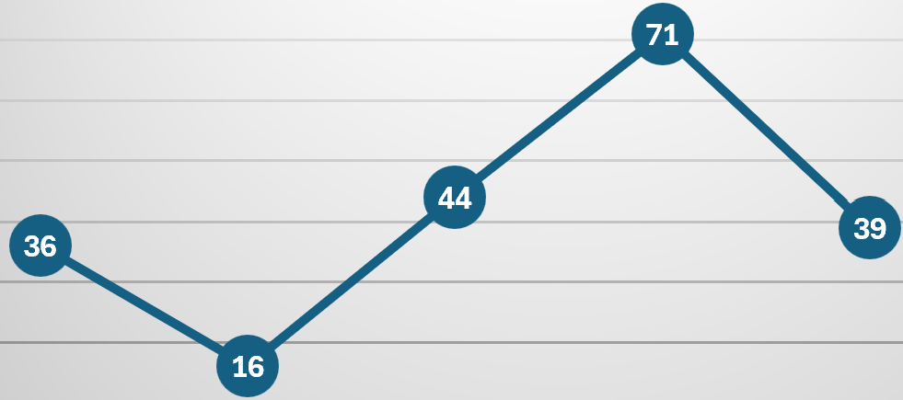
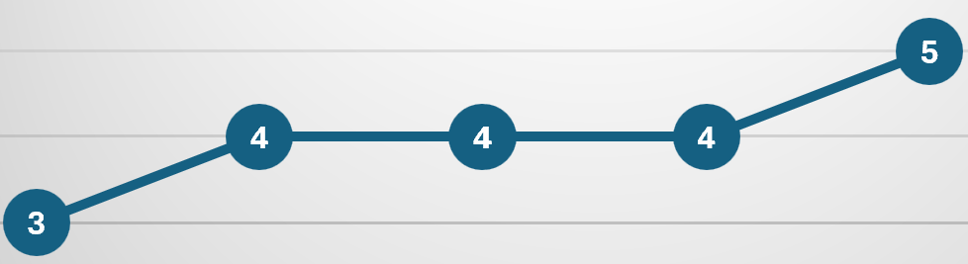
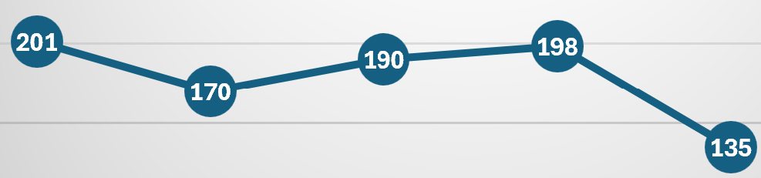
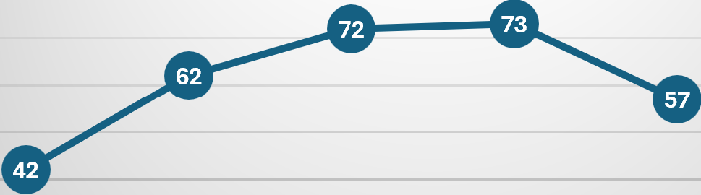
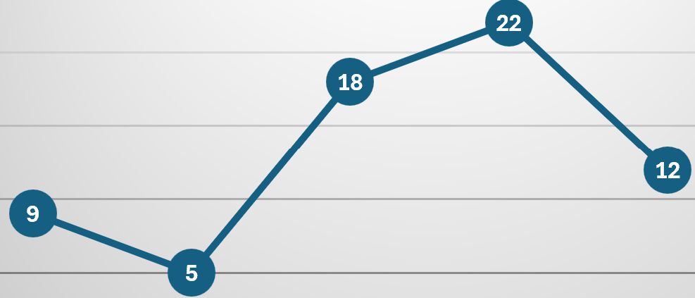
R2D Franchise Onboarding
Hari/Jeff
Date: 02/13/2025 to 02/19/2025 Scope: C+AI
Done
In Progress
At Risk
Need Help
R2D Franchises are up and running for majority of services, QCS are largely done. AEP franchise kicked off as of 02/19 . Identity Auth stack onboarded to R2D.
Data in grey is not yet useful due to metadata challenges – ETA to fix data is Sep ‘25, Service Tree is working on acceleration options.
Service Group Name | Franchise Owner CVP | QCS R2D | R2D Adopted/ In Scope | 5 Week Safefly Trend (Jan 19 – Feb 22) |  | #Skip/Escape | Comment
Azure CXP | Owner: Li Chen CVP: Angie Anderson | N/A | 41/75 |  |  | 0/0 | In Audit mode, Compliance data is being reviewed constantly.
AEE and AMP | Owner: Ruhiyyih Mahalati CVP: Annie Pearl, Brendan Burns | 3/3 | 65/180 |  |  | 2/1 | Franchise owners are reviewing compliance data weekly and following up with service owners to drive up the compliance..
Azure Networking | Owner: Li-Fen Wu CVP: Dave Maltz | 10/10 | 80/175 |  |  | 0/0 | High coverage, with async reviews and lease model to optimize for scale/speed. Revisiting risk model under discussion.
Azure Specialized | Owner: Mark Hennessy CVP: Eric Lockard | 1/1 | 12/64 |  |  | 1/0 | 100% PF compliance on R2D, Ongoing effort to increase R2D compliance for Ev2 thru deploy skips email. Franchise Owners & delegates strong support on R2D & SF compliance both in IDC and US. SF requests in increasing trend shows increase in awareness on R2D
Azure Storage | Owner: Marcus Swenson CVP: Maneesh Sah | 5/5 | 15/74 |  |  | 1/0 | R2D process is rigorously followed and requests are reviewed by R2D. PTD touches are closely monitored. Feedback has been provided to reduce data hygiene issues.
Core Compute & Host | Owner: Sushant Rewaskar CVP: Arun Kishan | 7/7 | 63/168 |  |  | 2/1 | Effort on Ev2 deploy skips email to EDs resulting in R2D & SF compliance & increasing awareness on Build ID guidance with service teams, Franchise owners & R2D Rep assisting service owners in addressing Build ID mismatches on Ev2 & driving awareness on R2D compliance..
One Fleet Platform | Owner: Imran Sargusingh CVP: Tim Mallalieu | N/A | 21/114 |  |  | 0/0 | High coverage, franchise in audit mode (starting with PF app, next EV2 )
Azure Data | Owner: Peter Carlin CVP: Peter Carlin | 10/10 | 17/118 |  |  | 1/0 | Decentralizing franchise model – wave 2 service plans in progress
Net Apps | Owner+CVP: Maneesh Sah | 1/1 | 1/1 |  |  | 0/0 | R2D processes started, 3P environment challenging for the testing details as these are outside of Msft processes (own Github). Following guidance clearly and #SF requests increasing. Adhering to Risk Assessment guidance.
Devdiv | Owner: Petr Podhorsky CVP: Bilal Alam | 5/5 | 69/81 |  |  | 0/0 | Franchise owners are monitoring compliance metrics on a weekly basis, close collaboration with PTC touches team to improve data accuracy. Actively working onboarding remaining 12 remaining in scope services.
Azure Databricks | Owner/CVP: Lindsey A./ Maneesh S. | 1/1 | 1/1 | N/A | N/A | 0/0 | DB RP is 100% onboarded, CP / DP status: working on cross-company CM process
AEP | Owner: Irina Gorbach CVP: John Sheehan | 2/2 | 21/75 |  |  | 1/0 | AEP franchise kicked off as of 02/19. No Skips or Escapes 13-20 Feb
AHSI | Owner: Jason Whitehorn CVP: Naga Gurumoorthy | 0/0 | 3/91 |  |  | 0/0 | 5 prioritized services are onboarded, Wave 2 onboarding in progress - 91 Services in scope as of now out of 308 services in AHSI, ETA MAR-25.
Identity | Owner: Vojtech Vondra CVP: Igor Sakhnov | 8/8 | 8/12 | TBD | 205 | 0/0 | IDNA QCS adopted R2D SF instance for Auth stack services and EQSP (2/8). Rest of QCS are still using the IDNA instance with 100% adoption.
Notes:
Breadcrumb 1 - R2D Franchises are up and running for majority of services, QCS are largely done. R2D Adoption is >1 deployment review in last 90 days
Breadcrumb 2 - Data in grey is accurate but not yet useful yet. Centralized bypass metrics for EV2 are pending taxonomy help from service tree for how test subscriptions are classified – This work starts in Bromine with an ETA Sep ‘25, we are looking at options to accelerate in progress.
////////////////
1: R2D scope is dependent on work to accurately service tree – so accuracy
2: Above arm subscription classification – subclassification

Slide 24
Mike
Anatomy of a Safe Action
Draft requirements
Safe Action Requirement | Description | How to achieve safety for GA Operations?
Risk Assessment of the change / touch | Identify impact and evaluate resource dependencies to understand blast radius / risk of the change. | Perform dependency analysis of the operation for potential failures Evaluate the blast radius of the operation Ensure the operation is appropriately tagged (i.e., high risk versus low) and scoped (i.e., applicable for your services’ resources)
Safety pre-checks for the change / touches | Author Safety pre-checks that return a go/no-go status before execution of impactful operations. | Use Shared Operations in available Geneva Actions (already published with safety prechecks) as applicable Include code for safety pre-checks depending on the resource targeted for the operation (e.g. resource in use before deletion of the resource)
Safety Policies for resources' availability | To protect the resources’ availability, evaluate the existing safety policies that platform currently supports. | Depending on the resource target, leverage the safety policies that are available to protect resources’ availability, including : Rate and Concurrency Limiting Deny Require Approval (via. Approval Service) Availability Groups For multi-input operations use batch operations safety with Approval Service
Separate Atomic operations versus Multi-Target Operations | Right tools and platforms are used for point operations (for single target) versus orchestrations across multi target. | Point operations for single target – for multiple targets leverage other orchestration services.
Testing and SDP prior to execution / roll out | Perform testing of the code to validate the operations are doing what is desired. Ensure SDP package publishing through non-prod, Beta, Canary and prod environments with automated tests , bake time and rollback. | Onboard to SDP package publishing feature for automated testing, baking and roll back of extension packages. Write proper tests to validate expected behavior and catch potential failures and execute on a periodic basis
Health Integration | Pre and Post Health checks to evaluate health of resource is performed. | Use workflow feature to chain multiple steps on the single target Pre (via. Workflow feature) and Post Health checks to be included for operations Include SLI signals where applicable for validations
Roll-Back Capability | Ability to revert to the previous state. | Tested rollback mechanism (as a separate operation or parameterized operation) for roll backs.

Slide 25
Production Touch Dashboard Improvement Plan
Production Touch Dashboard (aka.ms/ptd)
Start with SQCS services
With service owners (in progress):
1) Validate input data quality (completeness, freshness, accuracy, etc.)
Validate prod / non-prod classification approach
e.g. Subscription based services: service tree prod / non prod subscription tagging, resolve “mixed-use” subscriptions
e.g. Non-subscription services: Xstore - service specific resolution method
Address data quality gaps per service
e.g. Service fabric logs
2) Inventory [non]standard/[un]safe tools per use case (Geneva Actions, OaaS, Fleet Diagnostics, etc.)
New dashboard views (in progress):
1) all manual touches per service, risk level and source of touch
2) all automated touches per service, risk level and source of touch
Notes:
We trained the Open AI LLM model with sample data and use queries like this to get the risk level, We can share the spec for risk level classification if needed. Risklevel: “I will provide you with the OperationClusterName performed by the user in Azure. You need to predict how safe or unsafe are these Operations. Categorize each Operation Name into one of these risk levels: {moderate, high, extreme}. Strictly use only these for the output. Risk level here can be thought of as: while performing the operation, a mistake while using it can lead to an incident or outage (bigger the potential impact, higher the risk). Use your best judgement to determine the risk level for each of the OperationNames. Think of what these operation names might mean and their purpose. Take all the time you need to think of the correct answer, use chain of thoughts. Rethink when needed. Respond in 1 word ONLY.”

Slide 26
Jeff
Rubric – Quality Critical Repairs (qcrs)
Enabling consistent Repair items for Service Team and Central team mitigation and timelines 1. Start – create manually every week (tracking list to prevent duplicates)
2. Run – Automated Creation and reporting each week
Criteria | Scope | Tagging | Outage Condition | Repair item(s)
Onboarded to R2D | Service Team – Fan Out | AzRF.R2D.<Yes, No>
Auto health stops | Service Team – Fan Out | AzRF.Detection.Manual | Manual detected outage | Create / Update Monitor to catch outage earlier in stagemap
Rollback tested and proven to work in < 1 hour | Service Team – Fan Out | AzRF.Mitigation.Rollback | Rollback required ClickTouch Rollback > 1 hour | Create or update Rollback capability associated to this outage Due to ClickTouch Due to long rollback time
Enforced R2D for every change (code, config, data, prod touch) | Central | AzRF.ManualTouch.<Operation> AzRF.ClickTouch.<Operation> AzRF.SafeFly.<Mapped, NotMapped> | Change Related Outage with Skip or escape | Address gaps in team / DRI process to ensure R2D / SafeFly requests are completed for all production deployment and change (code, config, data, prod touch)
Enforce CCOA and enable Hi Pri monitoring of all high-risk changes | Central | AzRF.CCoA. <Enforced, NotEnforced> | Outage occurred and Hi-Pri monitoring ID is not linked | During CCoA, service team must provide a hi-pri monitoring link for each R2D / SafeFly request.
Provide central visibility into all changes (FCM) | Central | AzRF.FCM.<Yes, No> | Outage occurred and change was not found in FCM | FCM change associated to this Outage was not auto-discovered
All touches are automated via a standard platform/tool (OaaS, Geneva Actions) | Central Tool Owner |  | Ticket tagging or incident survey follow-up indicated a ClickTouch either causing the outage or as part of the outage response | Change was as a ClickTouch either for by a person or an automated script instead of using standard platform / tools (OaaS, Geneva Actions) Mitigation during the outage was made via a ClickTouch either by a person or an automated script instead of using standard platform / tools (OaaS, Geneva Actions)
Actions executed with least privilege and scoped with built-in safety checks | Service Team – Fan Out |  | Ticket tagging or incident survey follow-up indicated blast radius for access that needed scoped or reduced privileges

Slide 27
Safety Platform Capabilities
Mike
A Safe Platform must meet the principles below and provide platform capabilities to validate touch safety, each building upon the previous:
Change Classification – Provide the ability for system verified change / operation classification (to meet the standard taxonomy i.e. identify operation classes (like read vs. write)) and assign risk level to the change.
Access Controls and Security – Enforce granular RBAC and least privilege principles following the Critical Infrastructure Production Access Standard - SIDN principles.
Audited and Attributed Operations – Provide auditing and attribution of the touch/change to the identity that requested the activity. Ideally, provide correlation for the attribution to occur through the entire chain of entities involved, i.e. from the original identity to the safe platform to the targeted resource. Push logs into Production Touch Dashboard and FCM.
Managed Risk Review – Require review and approval prior to the change. Integration with BoQ / R2D / SafeFly process for risk assessment and approval to ensure the appropriateness, validity & impact of the change / operation. Maintain the integrity of the reviewed and approved changes to production.
Safety Pre-Checks – Provide the ability to define and perform pre-checks and validations (depending on the targeted resource) to ensure reduced inadvertent impact.
Safety Policies – Protection of resources’ availability by providing default policies for rate and concurrency limits for change execution.
Health Integration – Provide the ability for pre- and post- health checks to evaluate the health of the resource before proceeding with the next set of change / operations.
Testing and Safe Deployment Practices – Provide capability for testing of the code to validate the operations are doing what is desired. Ensure rollout of change through defined SDP channels such as non-prod, Beta, Canary, regional resilience and prod environments with automated tests, bake time and rollback.
Rollback – Ability to revert to the previously known good state if something was not completed successfully.
CCOA Support – Ability to support no fly periods and meet the requirement of approval process for any change during no-fly.
Duration: 01/01/2025 to 01/31/2025
Scope: Super QCS services
Count of all Non-Read operations performed by User identities

Slide 28
Production Touch Dashboard Click vs. Script Touch Legend
Target Type | Channel | Client Type | Touch Type
Geneva Actions | Browser | Mozilla, WebBrowser, insomnia, JarvisUI | Click Touch
 | Application | AzureSupportCenter, LaborService, Synthetics, EV2, Runner, GenevaActionsClientLibrary | Scripted
 | Console | GenevaActionsCmdlets, python | Scripted
 | Unknown | Other | Scripted
 | Client Library | GenevaActionsClientLibrary | Scripted
ARM | Application | Ev2 | Scripted
 | Console | PS, CLI | Scripted
 | Browser | Azure Portal | Click Touch
 | Client Library | Geneva Actions | Scripted
XDS | Application | WebBrowser, GenevaActions | Click Touch
 |  | Powershell, | Scripted
SLB | Console | Powershell | Scripted
 | Application | MessageBus | Scripted
Fabric | Console | Operators | Scripted
 | Unknown | Other | Click Touch
 | Client Library | XPatchDirect, GenevaActionsPublic | Click Touch
 | Titan | Titan | Click Touch
 | DCM-SaC |  | Scripted
 | Application | DCMX | Click Touch
dSMS | Client Library | genevaactions, dsmsproxy-client-version | Scripted
 | Unknown | Other | Click Touch
Other | Application | Accept Type, CRPdSTSACccess | Scripted
 | Unknown | Other | Click Touch
 | Browser | CPlatShellDSTSAccess | Click Touch
PilotFish | Application | Prorab, XTSApamLocal, XTSCockpitRelay | Scripted
NRP | Client Library |  | Click Touch
SDNPUBSUB | Unknown | Other | Click Touch
RNM | Console | CoreXT | Scripted
 | Client Library | Client Library | Scripted
 | Unknown | Other | Click Touch
SoC | ClientLibrary | SSHUsers | Scripted
 |  | RepairAgentCommands | Scripted

Slide 29
Risk Levels - Production Touch Dashboard
Risk Level | Description
Low Risk | Read operations without any critical terms (remove|delete|reset|create|update|secret|keyvault|cert) in OperationName OperationName with non-critical terms (get|read|cat|info|systemctl status|ifconfig|ipconfig|ping|dir|journalctl|echo)
Moderate | Read operations with critical terms (remove|delete|reset|create|update|secret|keyvault|cert). Possible non-read operations executed with Reader permissions. OperationName with non-prod terms (ppe|test|staging|-dev).
High | Predominantly 'Update' operations Some 'Delete' operations, which AI-based classification tagged as High Risk (lower than others tagged Extreme)
Extreme | Predominantly 'Delete' operations 'Update' operations for executing commands deemed as extreme risk by AI system.
Immediate Action Required | 'High' and 'Extreme' risk operations which have been executed via ‘Standard Systems’ (OaaS & Geneva Actions) by others. Represents high risk touches that are “shovel ready” to move to a standard system (OaaS, Geneva actions)
Note: No method exits to track resource-level criticality today (i.e. what is a “quality critical resource”). Proposal in progress to pilot a solution with an initial set of services
Reference: Production Touch Dashboard (aka.ms/ptd)
Notes:
We trained the Open AI LLM model with sample data and use queries like this to get the risk level, We can share the spec for risk level classification if needed. Risklevel: “I will provide you with the OperationClusterName performed by the user in Azure. You need to predict how safe or unsafe are these Operations. Categorize each Operation Name into one of these risk levels: {moderate, high, extreme}. Strictly use only these for the output. Risk level here can be thought of as: while performing the operation, a mistake while using it can lead to an incident or outage (bigger the potential impact, higher the risk). Use your best judgement to determine the risk level for each of the OperationNames. Think of what these operation names might mean and their purpose. Take all the time you need to think of the correct answer, use chain of thoughts. Rethink when needed. Respond in 1 word ONLY.”

Slide 30
Production Touch Taxonomy
Focus of the following slides
Touch | Manual Executed on demand by a user identity | Automated Automated execution by service identity
Click Touch | User executed a “click operation” e.g. Azure Portal clicks | N/A
Scripted/Code Touch | User executed a script/code e.g. ran a powershell script | Automation (orchestrator, etc.) invoked the script/code e.g. OaaS or Geneva Actions execution of an action in response to a trigger or schedule

